Slide 1
Performance Measures

Slide 2
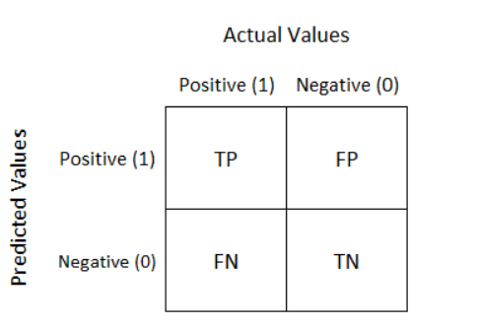
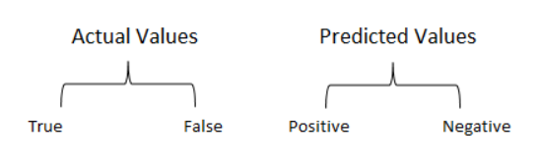
Confusion Matrix
A confusion matrix is a performance measurement technique for Machine learning classification.
It is an N x N matrix used for evaluating the performance of a classification model, where N is the number of target classes.
For a binary classification problem, it is a two-by-two table that contains four outcomes produced by a binary classifier.

Slide 3
Confusion Matrix
True Positive(TP):
Interpretation: You predicted positive and it’s true.
You had predicted that France would win the world cup, and it won.
True Negative(TN):
Interpretation: You predicted negative and it’s true.
You had predicted that England would not win, and it lost.
False Positive(FP): (Type 1 Error)
Interpretation: You predicted positive and it’s false.
You had predicted that England would win, but it lost.
False Negative(FN): (Type 2 Error)
Interpretation: You predicted negative and it’s false.
You had predicted that France would not win, but it won.
Just Remember, We describe predicted values as Positive and Negative and actual values as True and False.

Slide 4
Example 1
Total
4
6
Total
3
7
10

Slide 5
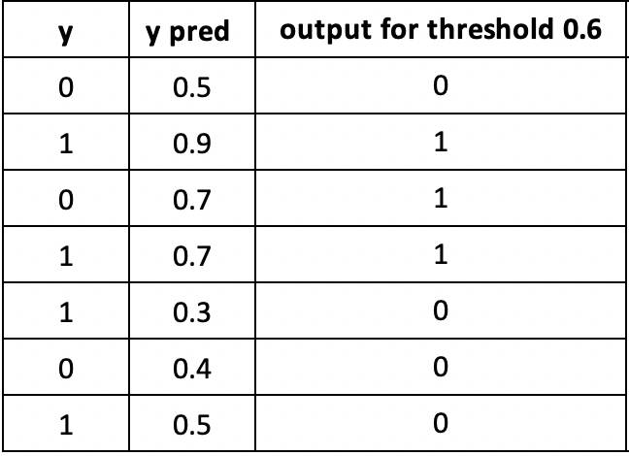
Example 2
TN
TP
FP
TP
FN
TN
FN

Slide 6
Example 2
TN
TP
FP
TP
FN
TN
FN

Slide 7
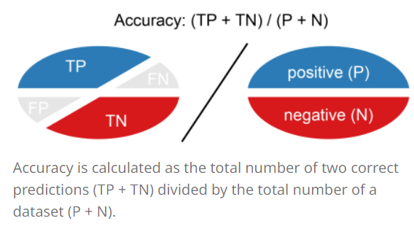
Accuracy
Accuracy (ACC) is calculated as the number of all correct predictions divided by the total number of the dataset.
The best accuracy is 1.0, whereas the worst is 0.0.
Overall, how often is the classifier correct?

Slide 8

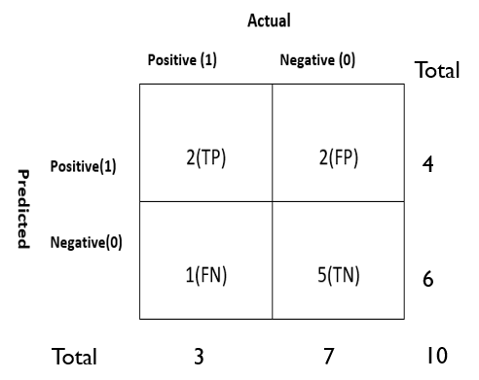
Accuracy(cont)
The accuracy would be calculated by the following formula
ACC= (2+5)/10 = 0.7
So the model is saying I can predict sick people 70% of the time.

Slide 9
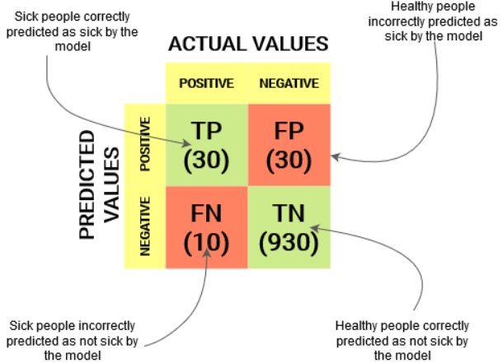
Confusion Matrix

Slide 10
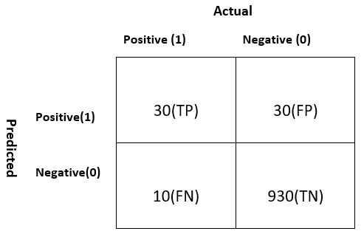
ACCURACY(cont)
Let’s take another example.
Total
ACC=(TP+TN)/P+N = (30+930)/1000 = 0.96
60
Our model is saying “I can predict sick people 96% of the time”.
940
Total
40
960
1000
Notes:
However, it is doing the opposite. It is predicting the people who will not get sick with 96% accuracy while the sick are spreading the virus! Do you think this is a correct metric for our model given the seriousness of the issue? Shouldnt we be measuring how many positive cases we can predict correctly to arrest the spread of the contagious virus? Or maybe, out of the correctly predicted cases, how many are positive cases to check the reliability of our model?
This is where we come across the dual concept of Precision and Recall.

Slide 11
Evaluation Metric: Accuracy
Network Prediction: 96% Accuracy
It tells: “I can predict sick people 96% of the time”.
However, it is doing the opposite.
It is predicting the people who will not get sick with 96% accuracy while the sick are spreading the virus! Because of TN
For Imbalanced Dataset: Classification Accuracy is not a correct measure

Slide 12
The Accuracy Trap
Say we are building a model that predicts if patients have a chronic illness.
We know that only 0.5% of the patients have the disease, or are “Positive” cases.
Now, a dummy model could always give “Negative” as a default result and still have a high accuracy (99.5%!) because our dataset is skewed.
Out of all the patients only 0.5% have the disease, so by giving “Negative” as a default answer for 100% of the cases, the model is still able to get the predictions right in 99.5% of the cases – we have a model with a very high accuracy! But is this of any good? Absolutely not! And this is where some other performance measures come into play.

Slide 13
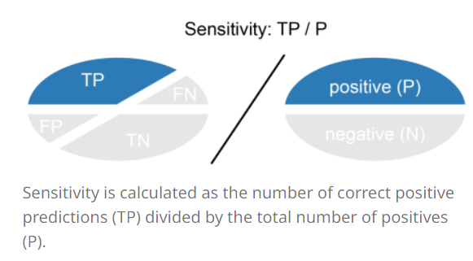
Recall/True positive rate/sensitivity
Recall (REC) is calculated as the number of correct positive predictions divided by the total number of positives.
It is also called sensitivity (SN) or true positive rate (TPR).
The best recall is 1.0, where as the worst is 0.0.
Recall tells us how many of the actual positive cases we were able to predict correctly with our model.
A low Recall can indicate many False Negatives.
Notes:
Recall tells us about the classifiers completeness.
It is stated as out of all the positive cases, how much we predicted correctly.

Slide 14
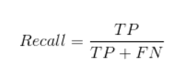
Recall(CONT)
The recall would be calculated by the following formula
Total
60
REC= 30/(30+10) = 0.75
940
75% of the positives were successfully predicted by our model. Awesome!
Total
40
960
1000
Notes:
Recall is a useful metric in cases where False Negative trumps False Positive.
Recall is important in medical cases where it doesn’t matter whether we raise a false alarm but the actual positive cases should not go undetected!
In our example, Recall would be a better metric because we don’t want to accidentally discharge an infected person and let them mix with the healthy population thereby spreading the contagious virus. Now you can understand why accuracy was a bad metric for our model.

Slide 15
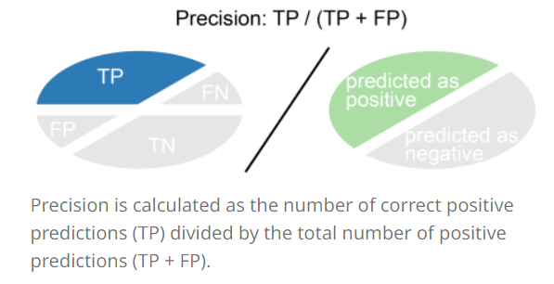
Precision
Precision (PREC) is calculated as the number of correct positive predictions divided by the total number of positive predictions.
It is also called positive predictive value (PPV).
The best precision is 1.0, whereas the worst is 0.0.
Precision tells us how many of the correctly predicted cases actually turned out to be positive.
A low Precision can indicate many False Positives.
Notes:
Precision tells us about the classifier’s exactness. It is stated as, out of all the positive samples (Class Label 1), predicted by the Model, how many are actually positive.

Slide 16

Precision(cont.)
The precision would be calculated by the following formula
Total
Precision= 30/(30+30)
60
50% percent of the correctly predicted cases turned out to be positive cases
This would determine whether our model is reliable or not.
940
Total
40
960
1000
Notes:
Precision is a useful metric in cases where False Positive is a higher concern than False Negatives.
Precision is important in music or video recommendation systems, e-commerce websites, etc. Wrong results could lead to customer churn and be harmful to the business.

Slide 17
Analysis: Precision vs Recall
Precision is a useful metric in cases where False Positive is a higher concern than False Negatives.
Recall is a useful metric in cases where False Negative trumps False Positive.
In previous example; Recall would be a better metric because we don’t want to accidentally discharge an infected person and let them mix with the healthy population thereby spreading the contagious virus.
Precision is important in music or video recommendation systems, e-commerce websites, etc. Wrong results could lead to customer churn and be harmful to the business.
Recall is important in medical cases where it doesn’t matter if we raise a false alarm, but the actual positive cases should not go undetected!
Notes:
Customer churn: attrition rate, num of customers who stopped using your product

Slide 18

F1-score
We prefer classifiers with High Precision and Recall.
But while tuning the classifiers, improving the Precision Score results in lower recall and vice versa when dealing with imbalanced datasets.
F1-Score inculcates both Precision and Recall and gives a single number that conveys the balance between Precision and Recall.
F1-score is a harmonic mean of Precision and Recall, and so it gives a combined idea about these two metrics.
F1-Score is between 0 and 1 and higher values are better.
Notes:
But there is a catch here. The interpretability of the F1-score is poor. This means that we don’t know what our classifier is maximizing – precision or recall? So, we use it in combination with other evaluation metrics which gives us a complete picture of the result.

Slide 19
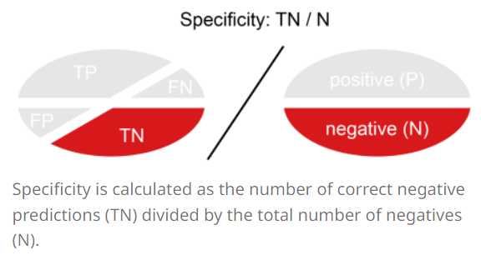
Specificity (True negative rate)
Specificity (SP) is calculated as the number of correct negative predictions divided by the total number of negatives.
It is also called true negative rate (TNR).
The best specificity is 1.0, whereas the worst is 0.0.
Notes:
fraud detection model in which all people whose credit card activity has been flagged as fraudulent (positive) will immediately go to jail. Of course, you don’t want to put any innocent person behind bars, meaning false positives here are unacceptable.

Slide 20

Specificity (True negative rate)
The specificity would be calculated by the following formula
Total
60
SP=930/960 = 0.96
940
Total
40
960
1000
Notes:
fraud detection model in which all people whose credit card activity has been flagged as fraudulent (positive) will immediately go to jail.
Of course, you don’t want to put any innocent person behind bars, meaning false positives here are unacceptable.

Slide 21
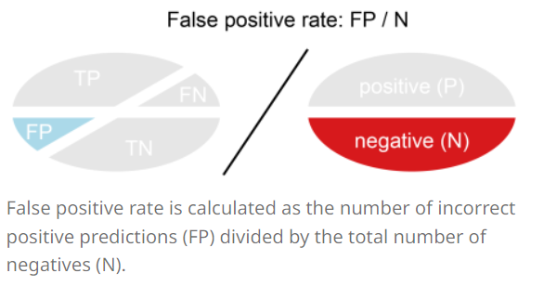
False positive rate
False positive rate (FPR) is calculated as the number of incorrect positive predictions divided by the total number of negatives.
The best false positive rate is 0.0 whereas the worst is 1.0.
It can also be calculated as 1 – specificity.

Slide 22

False positive rate
The specificity would be calculated by the following formula
Total
60
FPR=30/960 = 0.031
940
Total
40
960
1000
Notes:
A higher TNR(Specificity) and a lower FPR is desirable since we want to correctly classify the negative class.

Slide 23
PROBABILITY OF PREDICTION
A machine learning classification model can be used to predict the actual class of the data point directly or predict its probability of belonging to different classes.
We can determine our own threshold to interpret the result of the classifier.
Setting different thresholds for classifying positive class for data points will inadvertently change the Sensitivity and Specificity of the model.
One of these thresholds will probably give a better result than the others, depending on whether we are aiming to lower the number of False Negatives or False Positives.

Slide 24
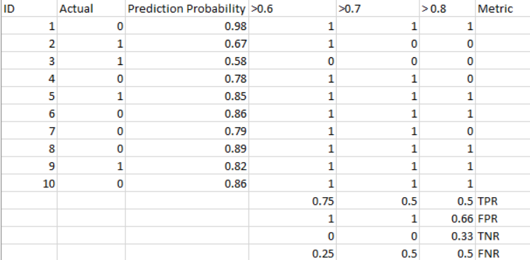
The AUC-ROC curve solves just that problem!
Notes:
The metrics change with the changing threshold values. We can generate different confusion matrices and compare the various metrics that we discussed in the previous section. But that would not be a prudent thing to do. Instead, what we can do is generate a plot between some of these metrics so that we can easily visualize which threshold is giving us a better result.

Slide 25
AUC-ROC Curve
The Receiver Operator Characteristic (ROC) curve is an evaluation metric for binary classification problems.
ROC curve shows the performance of a model at different classification thresholds
It is a probability curve that tells us how well the model is capable of distinguishing between classes
It plots two parameters True Positive Rate (TPR) and False Positive Rate (FPR)
The Area Under the Curve (AUC) is the measure of the ability of a classifier to distinguish between classes and is used as a summary of the ROC curve.
Once the curve has been made for different thresholds the Area under the curve shows us the Model’s performance.
The greater the area the better the performance of the model.

Slide 26
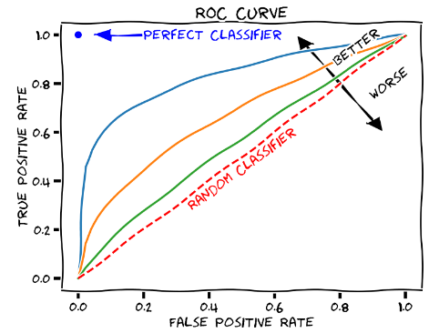
ROC Curve
The ROC curve is plotted with True Positive Rate (Recall/Sensitivity) against the False Positive Rate (FPR, 1 - Specificity) where TPR is on y-axis and FPR is on the x-axis
A higher X-axis value indicates a higher number of False positives than True negatives.
While a higher Y-axis value indicates a higher number of True positives than False negatives.
So, the choice of the threshold depends on the ability to balance between False positives and False negatives.

Slide 27
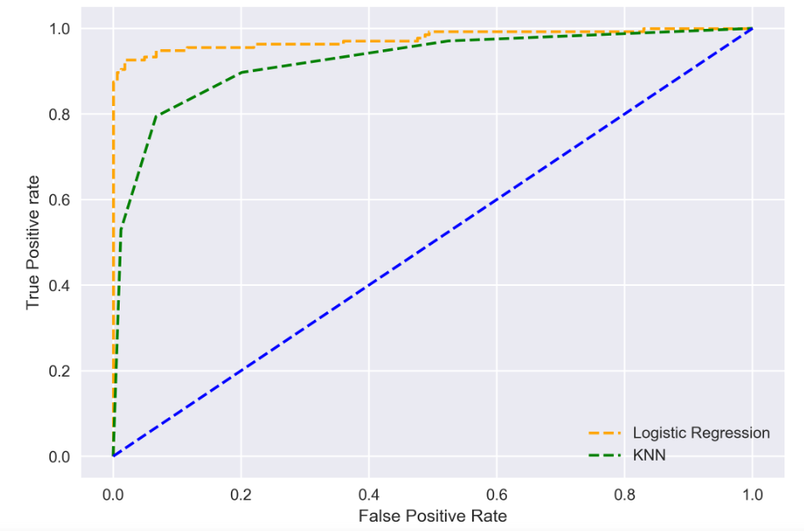
The higher the AUC, the better the performance of the model at distinguishing between the positive and negative classes.
When
AUC = 1
0.5<AUC<1
AUC=0.5
Notes:
When AUC = 1, then the classifier is able to perfectly distinguish between all the Positive and the Negative class points correctly. If, however, the AUC had been 0, then the classifier would be predicting all Negatives as Positives, and all Positives as Negatives.
When 0.5<AUC<1, there is a high chance that the classifier will be able to distinguish the positive class values from the negative class values. This is so because the classifier is able to detect more numbers of True positives and True negatives than False negatives and False positives.
When AUC=0.5, then the classifier is not able to distinguish between Positive and Negative class points. Meaning either the classifier is predicting random class or constant class for all the data points.
So, the higher the AUC value for a classifier, the better its ability to distinguish between positive and negative classes.

Slide 28
ROC-AUC: Threshold selection
The choice of threshold value depends on how the classifier is intended to be used.
If it is a cancer classification application you don’t want your threshold to be as big as 0.5. Even if a patient has a 0.3 probability of having cancer you would classify him to be 1.
Otherwise, in an application for reducing the limits on the credit card, you don’t want your threshold to be as less as 0.5.

Slide 29
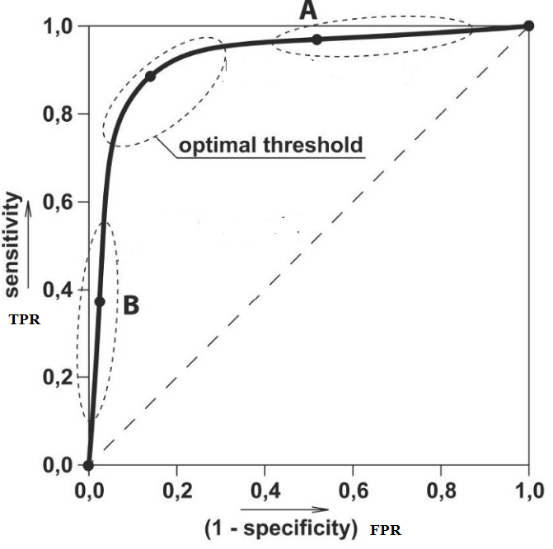
Notes:
Here we can use the ROC curves to decide on a Threshold value. The choice of threshold value will also depend on how the classifier is intended to be used.
AUC (Area Under the Curve) - ROC (Receiver Operating Characteristics) curve is a performance measurement for a classification model at various classification threshold settings. Basically, it is a probability curve that tells us how well the model is capable of distinguishing between classes. The higher the AUC value of our probability curve, the better the model is at predicting 0s as 0s and 1s as 1s.
A great model has AUC near the 1 indicating it has an excellent measure of separability. On the other hand, a poor model has AUC near to the 0 meaning it is predicting 0s as 1s and 1s as 0s. And When AUC is 0.5, it means the model has no class separation capacity whatsoever and it’s essentially making random predictions.

Slide 30
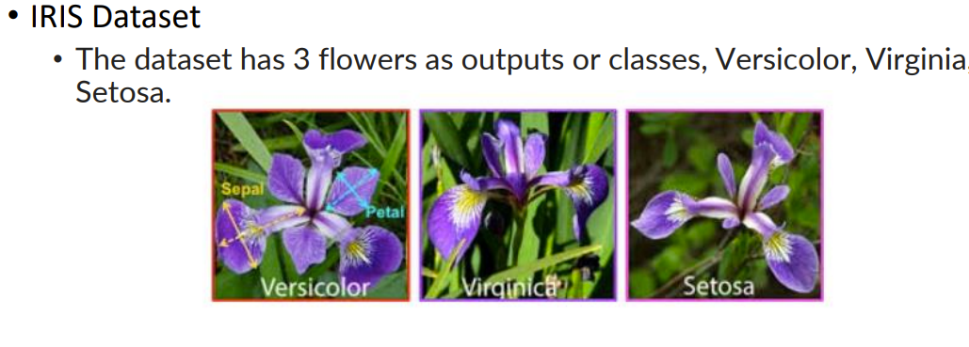
Confusion Matrix: Multiclass
Notes:
https://www.educative.io/answers/what-is-the-difference-between-micro-and-macro-averaging

Slide 31
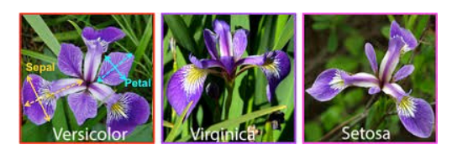
Confusion Matrix: Multiclass
IRIS Dataset
The dataset has 3 flowers as outputs or classes, Versicolor, Virginia, Setosa.
How to calculate TP, FP, TN, FN
Notes:
FN: actual pos predict neg
FP: actual neg predict pos

Slide 32
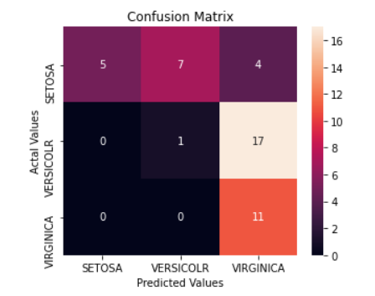
Confusion Matrix: Multiclass
How to calculate TP :
TP: The True positive value is where the actual value and predicted value are the same.
For SETOSA:
TP= 5 (R1C1)

Slide 33
Accuracy
Accuracy measures the proportion of correctly classified cases from the total number of objects in the dataset. To compute the metric, divide the number of correct predictions by the total number of predictions made by the model.
accuracy represents the proportion of correct predictions among all the instances.
Accuracy=correct prediction/All instances
Notes:
https://www.evidentlyai.com/classification-metrics/multi-class-metrics#precision-and-recall-in-multi-class

Slide 34
Confusion Matrix: Multiclass
How to calculate FN, FP, TN, TP :
FN: The False-negative value for a class will be the sum of values of corresponding rows except for the TP value.

Slide 35
Confusion Matrix: Multiclass
How to calculate FN, FP, TN, TP :
FN: The False-negative value for a class will be the sum of values of corresponding rows except for the TP value.
For SETOSA:
FN= 7 + 4

Slide 36
Confusion Matrix: Multiclass
How to calculate FN, FP, TN, TP :
FP: The False-positive value for a class will be the sum of values of the corresponding column except for the TP value.
For SETOSA:
FN= 7 + 4 (R1C2+ R1C3)
FP= 0 + 0 (R2C1 + R3C1)

Slide 37
Confusion Matrix: Multiclass
How to calculate FN, FP, TN, TP :
TN: The True Negative value for a class will be the sum of values of all columns and rows except the values of that class that we are calculating the values for.
For SETOSA:
FN= 7 + 4 (R1C2+ R1C3)
FP= 0 + 0 (R2C1 + R3C1)
TN= 1 + 17 + 0 + 11 (R2C2 + R2C3 + R3C2 + R3C3

Slide 38
Confusion Matrix: Multiclass
How to calculate FN, FP, TN, TP :
FN: The False-negative value for a class will be the sum of values of corresponding rows except for the TP value.
FP: The False-positive value for a class will be the sum of values of the corresponding column except for the TP value.
TN: The True Negative value for a class will be the sum of values of all columns and rows except the values of that class that we are calculating the values for.
TP: The True positive value is where the actual value and predicted value are the same.

Slide 39
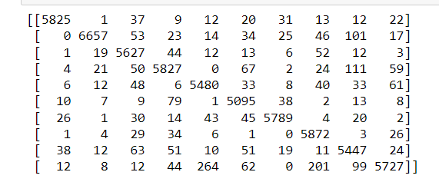
Multiclass Classification: Confusion Matrix
MNIST Dataset: labels[0-9]

Slide 40
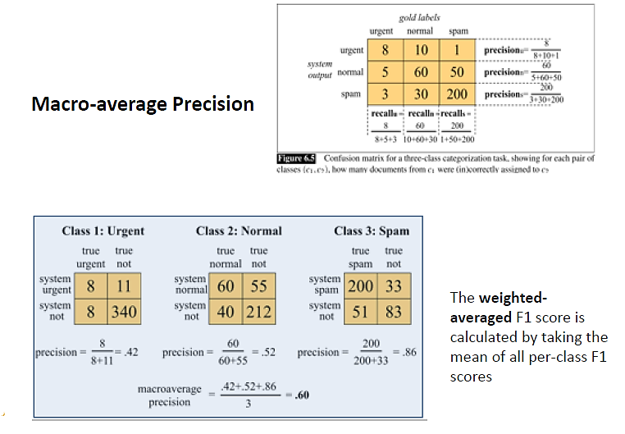
Notes:
Gold labels: actual/ground truth
Class 2 normal:
40 =10+30
212= 8+1+3+200

Slide 41
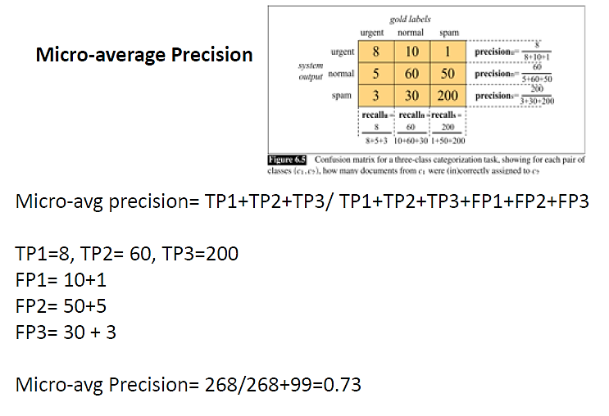

Slide 42
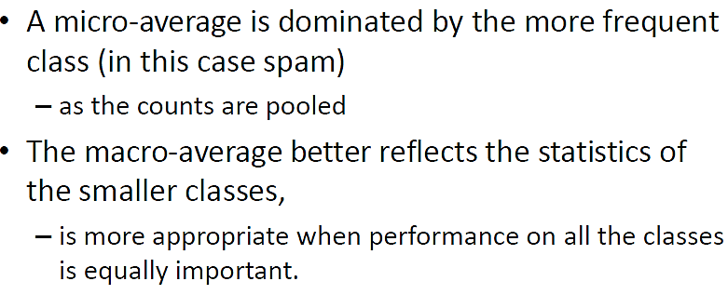

Slide 43
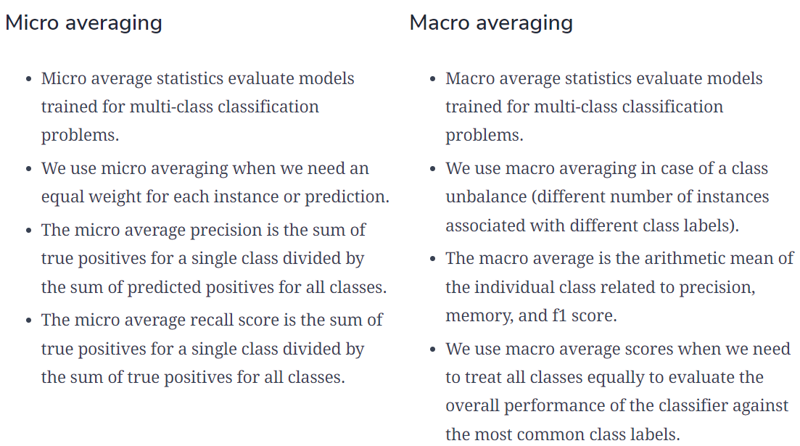
Notes:
https://www.educative.io/answers/what-is-the-difference-between-micro-and-macro-averaging

Slide 44
Test and train Split
An important decision when developing any machine learning model is how to evaluate its final performance
To get an unbiased estimate of the model’s performance, we need to evaluate it on the data we didn’t use for training.
The simplest way to split the data is to use the train-test split method.
It randomly partitions the dataset into two subsets (called training and test sets) so that the predefined percentage of the entire dataset is in the training set.
Then, we train our machine learning model on the training set and evaluate its performance on the test set. In this way, we are always sure that the samples used for training are not used for evaluation and vice versa.
Usually, we use 80/20 split.

Slide 45
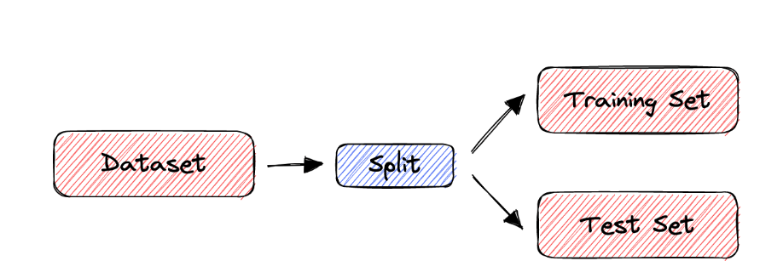
Test and train Split

Slide 46
Cross Validation
The train-split method has certain limitations. When the dataset is small, the method is prone to high variance.
To deal with this issue, we use cross-validation to evaluate the performance of a machine-learning model.
In cross-validation, we don’t divide the dataset into training and test sets only once.
Instead, we repeatedly partition the dataset into smaller groups and then average the performance in each group. That way, we reduce the impact of partition randomness on the results.
Notes:
However, the train-split method has certain limitations. When the dataset is small, the method is prone to high variance. Due to the random partition, the results can be entirely different for different test sets. Why? Because in some partitions, samples that are easy to classify get into the test set, while in others, the test set receives the ‘difficult’ ones.

Slide 47
K-Fold CROSS VALIDATION METHOD
“k-fold Cross-Validation” (e.g., k=10)
randomly partition our full data set into k disjoint subsets (each roughly of size n/k, n = total number of training data points)
for i = 1:10 (here k = 10)
train on 90% of data,
Acc(i) = accuracy on other 10%
end
Cross-Validation-Accuracy = 1/k Σ_{i} Acc(i)
choose the method with the highest cross-validation accuracy
common values for k are 5 and 10

Slide 48
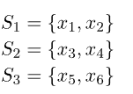

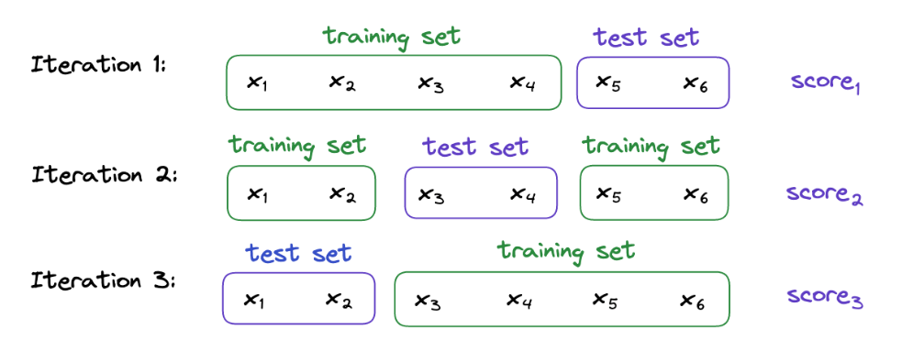
Notes:
For example, let’s suppose that we have a dataset containing 6 samples and that we want to perform a 3-fold cross-validation.
First, we divide into 3 subsets randomly. For instance:
Then, we train and evaluate our machine-learning model 3 times. Each time, two subsets form the training set, while the remaining one acts as the test set. In our example:

Slide 49
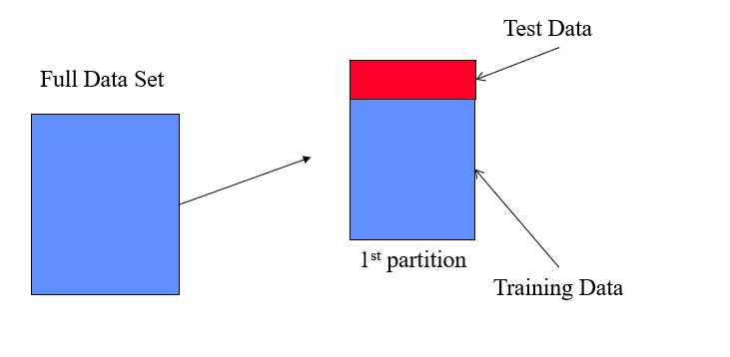

Slide 50
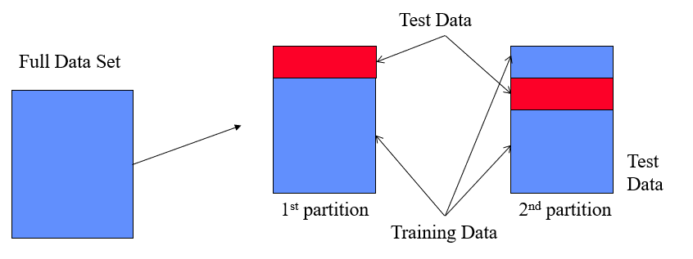

Slide 51
